Slide 1
ProTrack 360
Demo 1
A database project software

Slide 2
Introduction
Demo 1 Presentation
ProTrack360
Protrack Overview:
Database project management software
Academic driven
Current software

Slide 3
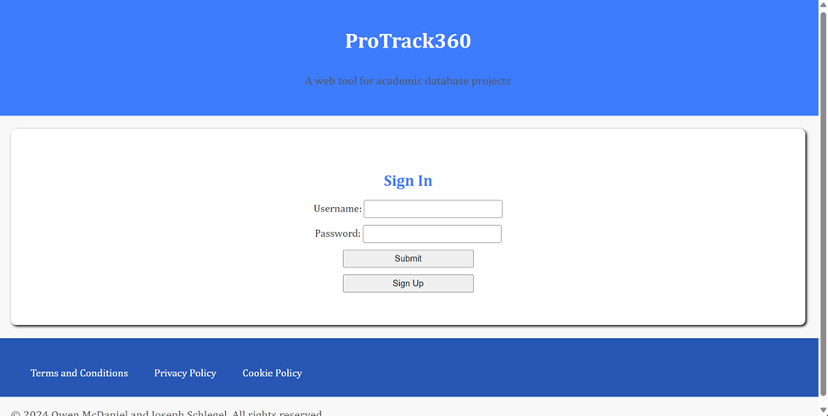
Sign In:
https://schlegs88.github.io/ProTrackCS360/

Slide 4
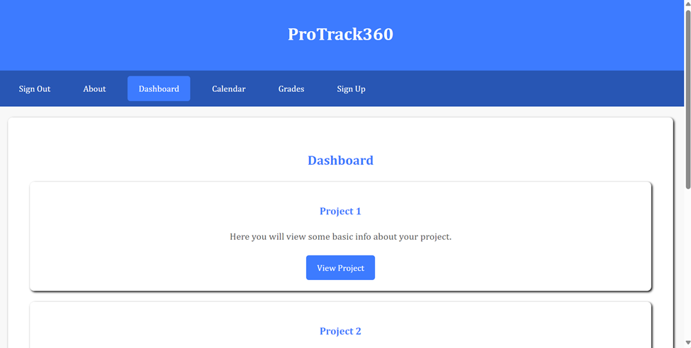
Dashboard
https://schlegs88.github.io/ProTrackCS360/dashboard.html

Slide 5
Main design features
Split-Use
Calendar
Evaluation
Students and instructors will have different permissions and features at their disposal to best suit each of their needs. There will be a one-to-many relationship between the instructor and students.
ProTrack360 will automatically create and update a calendar for each student, showing them not only when deliverables are due, but also when they should finish steps of the process.
Instructors will be able to provide clear evaluation standards via a rubric. After evaluating each project, the students will be able to view relevant feedback.

Slide 6
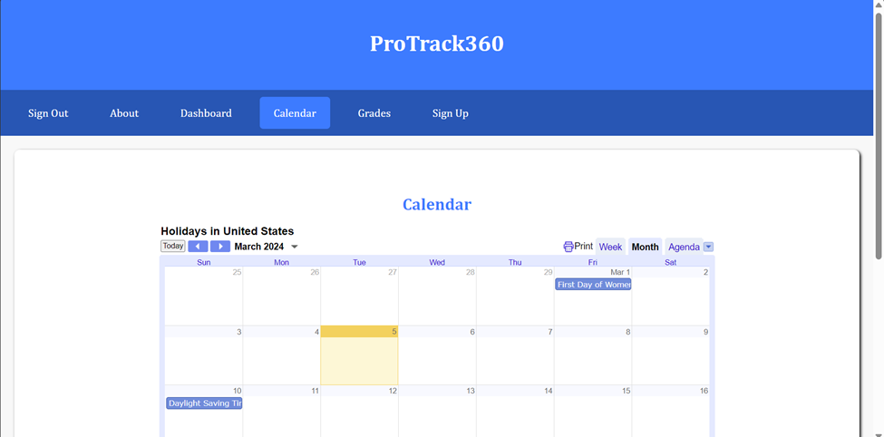
Calendar
https://schlegs88.github.io/ProTrackCS360/calendar.html

Slide 7
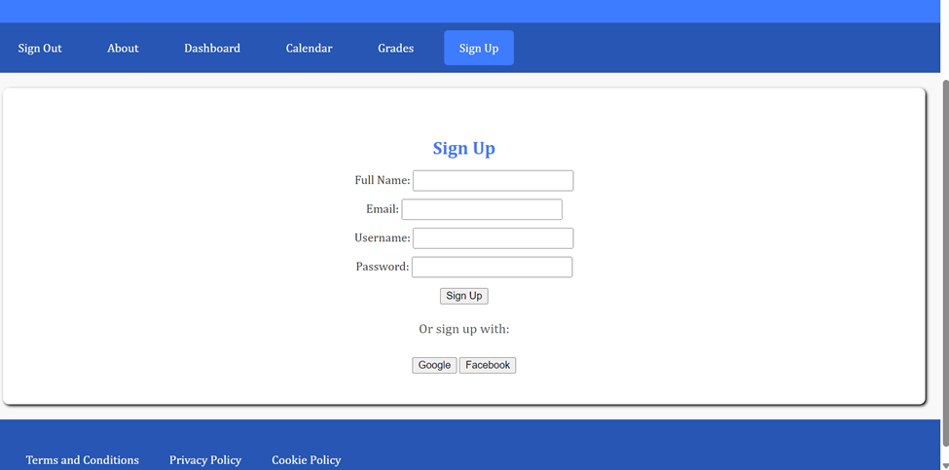
Sign Up
https://schlegs88.github.io/ProTrackCS360/signup.html

Slide 8
ProTrack360
Joseph Schlegel and Owen McDaniel

